Slide 1
Algorithms Analysis
Dr. Ramalingaswamy cheruku

Slide 2
What is an Algorithm
An Algorithm is a finite sequence of instructions, each of which has a clear meaning and can be performed with a finite amount of effort in a finite length of time. No matter what the input values may be, an algorithm terminates after executing a finite number of instructions.
Properties:
Definiteness: each instruction must be clear and unambiguous;
Finiteness: if we trace out the instructions of an algorithm, then for all cases the algorithm will terminate after a finite number of steps;
Effectiveness: every instruction must be sufficiently basic that it can in principle be carried out by a person using only pencil and paper.

Slide 3
Analysis of Algorithms
For the execution of an algorithm one needs CPU for computation and memory to store the program and data. The analysis of algorithms or performance analysis means calculating the time and space required for the execution of an algorithm.
Posterior analysis: doing analysis After coding.
Apriori analysis: doing the analysis before we code.
Hint: need to identify the basic operations/instruction in the algorithm and count the number of times that operation is being performed.
While doing instruction count:
Macro Analysis: perform instruction count for all operations.
Micro analysis: only for dominating operations

Slide 4
Basic operatrions
Problem | Basic /Dominant operations
Searching and sorting algorithms | Comparisons
Matrix multiplication algorithms | Multiplication and additions

Slide 5
Given two algorithms for a task, how do we find out which one is better?
One naive way of doing this is – implement both the algorithms and run the two programs on your computer for different inputs and see which one takes less time.
There are many problems with this approach for analysis of algorithms. 1) It might be possible that for some inputs, first algorithm performs better than the second. And for some inputs second performs better ---Input Dependent. 2) It might also be possible that for some inputs, first algorithm perform better on one machine and the second works better on other machine for some other inputs—Machine dependent.

Slide 6
How to get rid of these issues of algorithms ?
Solution: Asymptotic Analysis

Slide 7
Asymptotic Analysis
Asymptotic Analysis is the big idea that handles above issues in analyzing algorithms.
In Asymptotic Analysis, we evaluate the performance of an algorithm in terms of input size (we don’t measure the actual running time). We calculate, how does the time (or space) taken by an algorithm increases with the input size.

Slide 8
Time Complexity Is a Function
Specifies how the running time depends on the size of the input.
A function mapping
“size” of input
“time” T(n) executed .

Slide 9
Definition of Time
# of seconds (machine, implementation dependent).
# lines of code executed.
# of times a specific operation is performed (e.g., addition).

Slide 10
Asymptotic analysis
Time efficiency is analyzed by determining the number of repetitions of the basic operation as a function of input size
Basic operation: the operation that contributes most towards the running time of the algorithm.
T(n) ≈ c_{op}C(n)
input size
running time
Number of times basic operation is executed
execution time
for basic operation

Slide 11
Input size and basic operation examples
Problem | Input size measure | Basic operation
Search for key in a list of n items
Multiply two matrices of floating point numbers
Compute a^{n}
Graph problem
Notes:
regarding a^{n} point out that the input size measure is more properly measured by
number of bits:
b= ⌊log₂ n⌋ + 1
Graph problems are mentioned here just to give me an opportunity to discuss
them in general. Typically this will depend on graph representation and the specific
problem.

Slide 12
Input size and basic operation examples
Problem | Input size measure | Basic operation
Search for key in a list of n items | Number of items in the list: n | Key comparison
Multiply two matrices of floating point numbers
Compute a^{n}
Graph problem

Slide 13
Input size and basic operation examples
Problem | Input size measure | Basic operation
Search for key in a list of n items | Number of items in the list: n | Key comparison
Multiply two matrices of floating point numbers | Dimensions of matrices | Floating point multiplication
Compute a^{n}
Graph problem

Slide 14
Input size and basic operation examples
Problem | Input size measure | Basic operation
Search for key in list of n items | Number of items in list n | Key comparison
Multiply two matrices of floating point numbers | Dimensions of matrices | Floating point multiplication
Compute a^{n} | n | Floating point multiplication
Graph problem

Slide 15
Input size and basic operation examples
Problem | Input size measure | Basic operation
Search for key in list of n items | Number of items in list n | Key comparison
Multiply two matrices of floating point numbers | Dimensions of matrices | Floating point multiplication
Compute a^{n} | n | Floating point multiplication
Graph problem | #vertices and/or edges | Visiting a vertex or traversing an edge

Slide 16
Theoretical analysis of time efficiency
Time efficiency is analyzed by determining the number of repetitions of the basic operation as a function of input size

Slide 17
Algorithm Analysis
we discussed how Asymptotic analysis overcomes the problems of naive way of analyzing algorithms.
While analyzing an algorithm we can have three cases : 1) Worst Case 2) Average Case 3) Best Case

Slide 18
Example:
Now, we will take an example of Linear Search and analyze it using Asymptotic analysis.
Let us consider the following implementation of Linear Search.
#include <stdio.h> // Linearly search x in arr[]. If x is present then return the index, // otherwise return -1 int search(int arr[], int n, int x) { int i; for (i=0; i<n; i++) { if (arr[i] == x) return i; } return -1; } /* Driver program to test above functions*/ int main() { int arr[] = {1, 10, 30, 15}; int x = 30; int n = sizeof(arr)/sizeof(arr[0]); printf("%d is present at index %d", x, search(arr, n, x)); getchar(); return 0; }

Slide 19
Example: Sequential search
Problem: Given a list of n elements and a search key K, find an element equal to K, if any.
Algorithm: Scan the list and compare its successive elements with K until either a matching element is found (successful search) or the list is exhausted (unsuccessful search)
Worst case
Best case
Average case

Slide 20
Worst Case Analysis (Usually Done)
In the worst case analysis, we calculate upper bound on running time of an algorithm.
We must know the case that causes maximum number of operations to be executed.
For Linear Search, the worst case happens when the element to be searched (x in the above code) is not present in the array. When x is not present, the search() functions compares it with all the elements of arr[] one by one.
Therefore, the worst case time complexity of linear search would be Θ(n).

Slide 21
Average Case Analysis (Sometimes done)
In average case analysis, we take all possible inputs and calculate computing time for all of the inputs.
Sum all the calculated values and divide the sum by total number of inputs.
We must know (or predict) distribution of cases.
For the linear search problem, let us assume that all cases are uniformly distributed (including the case of x not being present in array). So we sum all the cases and divide the sum by (n+1). Following is the value of average case time complexity.

Slide 22
Best Case Analysis (Bogus)
In the best case analysis, we calculate lower bound on running time of an algorithm.
We must know the case that causes minimum number of operations to be executed.
In the linear search problem, the best case occurs when x is present at the first location. The number of operations in the best case is constant (not dependent on n).
So time complexity in the best case would be Θ(1)

Slide 23
Things to remember
Most of the times, we do worst case analysis to analyze algorithms. In the worst analysis, we guarantee an upper bound on the running time of an algorithm which is good information.
The average case analysis is not easy to do in most of the practical cases and it is rarely done. In the average case analysis, we must know (or predict) the mathematical distribution of all possible inputs.
The Best Case analysis is bogus. Guaranteeing a lower bound on an algorithm doesn’t provide any information.

Slide 24
Asymptotic Notations
The main idea of asymptotic analysis is to have a measure of efficiency of algorithms that doesn’t depend on machine specific constants, and doesn’t require algorithms to be implemented and time taken by programs to be compared.
Asymptotic notations are mathematical tools to represent time complexity of algorithms for asymptotic analysis.
The following 3 asymptotic notations are mostly used to represent time complexity of algorithms
-Theta notation
Big O notation
Big Ω Notation

Slide 25
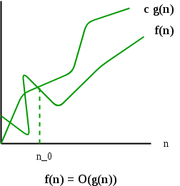
Big O Notation:
The Big O notation defines an upper bound of an algorithm.
The Big O notation is useful when we only have asymptotic upper bound on time complexity of an algorithm. Many times we easily find an upper bound by simply looking at the algorithm.
The O(g(n)) is the set of functions which satisfies as follows:
O(g(n)) = { f(n): there exist positive constants c and n0 such that 0 <= f(n) <= cg(n) for sufficient large values of n >= n0
s}

Slide 26

Little 0h
The function f(n)= o(g(n)) ifff
$\lim_{n→∞}{\frac{f(n)}{g(n)}}=0$
Its means little o() means loose upper-bound of f(n).

Slide 27
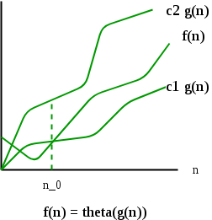
Θ Notation (theta notation )
Θ Notation: The theta notation bounds a functions from above and below, so it defines exact asymptotic behavior.
For a given function g(n), we denote Θ(g(n)) as following set of functions.
Θ(g(n)) = { f(n): there exist positive constants c1, c2 and n0 such that 0 <= c1*g(n) <= f(n) <= c2*g(n) for all n >= n0 }.
The expression Θ(g(n)) is set of functions { f(n) :∃c1,c2,n0∈N, ∀n≥n0, 0≤c1g(n)≤f(n)≤c2g(n)}
The above definition means, if f(n) is theta of g(n), then the value f(n) is always between c1*g(n) and c2*g(n) for sufficient large values of n (n >= n0). n0.

Slide 28
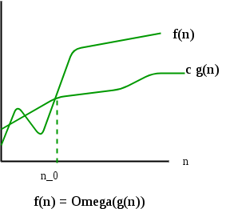
Ω Notation
Ω Notation: Just as Big O notation provides an asymptotic lower bound on a function
Ω Notation can be useful when we want to evaluate lower bound time complexity of an algorithm (best case).
The Omega notation is the least used notation among all three.
For a given function g(n), we denote by Ω(g(n)) as the set of functions that satisfies as follows:
Ω (g(n)) = {f(n): there exist positive constants c and n0 such that 0 <= cg(n) <= f(n) for sufficiently large value of n >= n0
}.

Slide 29

Little omega (w)
The function f(n)= w(g(n)) ifff
$\lim_{n→∞}{\frac{g(n)}{f(n)}}=0$
Its means little w() means loose lower-bound of f(n).

Slide 30
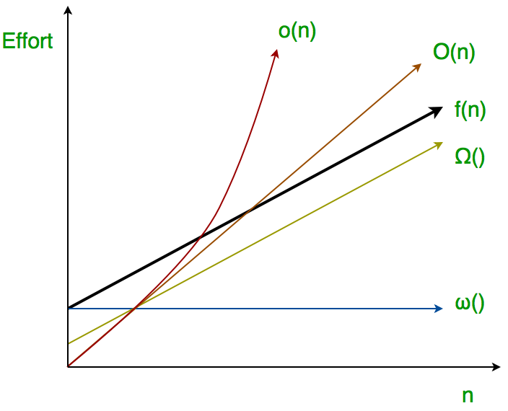
All notations

Slide 31
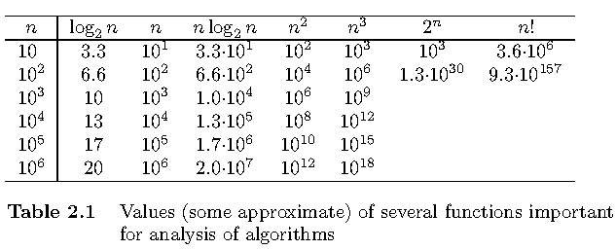
Order of Growth

Slide 32
There are two more notations called little o and little omega. Little o provides strict upper bound (equality condition is removed from Big O) and little omega provides strict lower bound (equality condition removed from big omega)

Slide 33
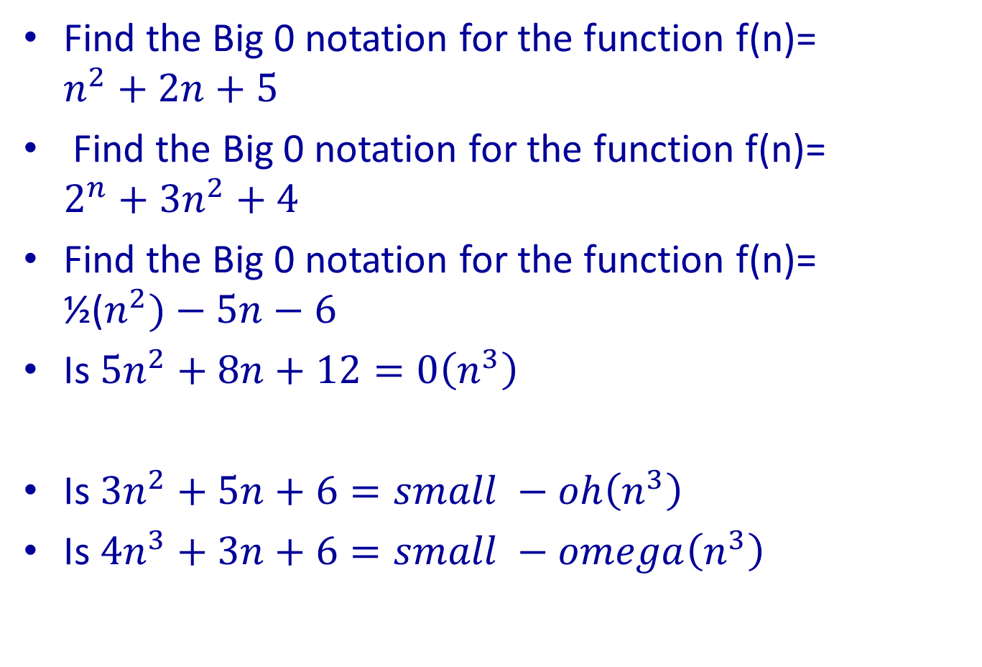
Problems:
Find the Big 0 notation for the function f(n)= $n^{2}+2n+5$
Find the Big 0 notation for the function f(n)= $2^{n}+3n^{2}+4$
Find the Big 0 notation for the function f(n)= ½($n^{2})−5n−6$
Is ${5n}^{2}+8n+12=0\left(n^{3}\right)$
Is ${3n}^{2}+5n+6=small −oh\left(n^{3}\right)$
Is ${4n}^{3}+3n+6=small −omega\left(n^{3}\right)$

Slide 34
Queries ??

Slide 35
Thank you !

